Slide 1





3/31/24, 8:45 PM
AWS CDK vs Terraform. An in-depth comparison of AWS CDK and… | by Stuart Cameron | Dev Axe | Medium
AWS CDK vs Terraform
An in-depth comparison of AWS CDK and Terraform, exploring their features, benefits, and best-use scenarios to guide users in choosing the right Infrastructure as Code tool.
Stuart Cameron · Follow
Published in Dev Axe
6 min read · Aug 20, 2023
Listen
Share
Introduction

Slide 2
3/31/24, 8:45 PM AWS CDK vs Terraform. An in-depth comparison of AWS CDK and… | by Stuart Cameron | Dev Axe | Medium
So you’re looking to get started with Infrastructure as Code (IaC) but you’re not quite sure which tool to begin with? You’ve asked your friends and colleagues for advice and while no one tool stood out, AWS Cloud Development Kit (AWS CDK) and Terraform were mentioned the most. But which one should you choose and why?
What is Infrastructure as Code?
Before comparing AWS CDK and Terraform, it’s important to first understand what Infrastructure as Code means and how it came to be. Back in the early 2000’s when modern utility computing started to come to the fore, and around the time when AWS released Simple Queue Service (SQS), scaling and other issues raised their heads. Infrastructure as Code was the answer to some of these issues. IaC is simply defining cloud infrastructure in machine readable code. This process opens up a number of possibilities and benefits:
Source Control — by defining your infrastructure in code all changes are tracked and rollbacks become much easier.
Reproducibility — you can use the same files to deploy the same infrastructure in multiple environments without worrying about human error.
Understanding — the IaC files act as their own documentation and other engineers can read the code to quickly understand the infrastructure.
What is AWS CDK?
AWS CDK is a relatively new tool, having been released by AWS in 2019. The aim of AWS CDK was to solve some of the issues that folks had with other tools such as AWS CloudFormation such as the amount of boilerplate code required, language constraints and verbosity.
AWS CDK lets an engineer imperatively define their infrastructure in a familiar language such as Typescript, Python or Java and then synthesize it to CloudFormation to build.
Key Features and Benefits
Constructs
AWS CDK is built on the concept of constructs. These are basically building blocks that let you quickly build up complex infrastructure with much less effort. AWS CDK ships with these constructs out of the box which makes the process of provisioning

Slide 3
3/31/24, 8:45 PM AWS CDK vs Terraform. An in-depth comparison of AWS CDK and… | by Stuart Cameron | Dev Axe | Medium
infrastructure much quicker and less verbose. Custom constructs can also be created and shared with the community.
Abstraction
AWS CDK abstracts away a lot of the configuration traditionally required in more declarative tools such as CloudFormation. This allows you to shift focus back to what you are building without having to worry about the nitty-gritty of resource configuration. Constructs vary in level of abstraction from L1 (lowest level of abstraction) to L3 (highest level of abstraction).
Familiar Programming Languages
AWS CDK supports a broad range of popular programming languages including Typescript, Javascript, Python, Go, C#/.Net and Java. This shortens the learning curve for newcomers because they don’t have to learn a new, domain-specific language.
What is Terraform?
Now on to Terraform. Released in 2014, HashiCorp Terraform is a slightly more mature product than AWS CDK. Mitchell Hashimoto, one of the creators of Terraform, liked the idea of AWS CloudFormation but saw some flaws — the main one being that it was not cloud agnostic. He wanted a product that could be used across different cloud providers.
Terraform uses HashiCorp’s own proprietary language called HashiCorp Configuration Language (HCL) to declaratively define infrastructure. In 2022, however, Hashicorp worked with AWS to release CDK for Terraform which opens up more language possibilities within Terraform.
Key Features and Benefits
Platform agnostic
The standout feature of Terraform is that it is cloud agnostic meaning that you can use it to automate the provisioning of cloud resources with multiple different cloud providers. You can define your infrastructure in HCL and use a common workflow to provision infrastructure in AWS, GCP and Azure.
State management
Terraform stores your infrastructure state in a Terraform state file. This allows Terraform to compare and map your configuration with your deployed infrastructure to plan what to build and to detect drift.

Slide 4
3/31/24, 8:45 PM AWS CDK vs Terraform. An in-depth comparison of AWS CDK and… | by Stuart Cameron | Dev Axe | Medium
Modular and reusable code
Terraform modules, similar but not quite the same as AWS CDK Constructs, allow you to wrap infrastructure definitions into reusable components. These can be shared both internally and across the community, reducing duplication and increasing speed.
Comparison: AWS CDK vs Terraform Language Support
AWS CDK
AWS CDK supports a number of popular programming languages:
Typescript Javascript Python
Go C#/.Net Java
Terraform
Terraform supports HashiCorp Configuration Language (HCL) which is a proprietary language. It is designed to be both human and machine readable.
As mentioned above, CDK for Terraform allows you to use the CDK supported languages:
TypeScript Python Java, C#/.Net
Go
Platform Support
AWS CDK

Slide 5
3/31/24, 8:45 PM AWS CDK vs Terraform. An in-depth comparison of AWS CDK and… | by Stuart Cameron | Dev Axe | Medium
AWS CDK is designed for use with AWS resources and is tightly integrated with their other services. However, there is limited support for third-party resources such as GitHub, MongoDB and Okta (see here for more).
Terraform
Terraform was born out of the idea that it should be platform agnostic so it’s no surprise that it supports a lot more platforms than AWS CDK, including AWS, Google Cloud Platform, Microsoft Azure and Oracle Cloud.
State Management
AWS CDK
When deploying AWS CDK, it is first synthesized to CloudFormation. CloudFormation then manages state for you out of the box.
Terraform
In Terraform, state is managed locally by default in a file called terraform.tfstate. However, it can be configured to be managed remotely to synchronize state and add versioning.
Community and Ecosystem
AWS CDK
The AWS community in itself is very large and vibrant — and has been a large contributor to its success — and this has also extended to AWS CDK. There are a growing number of community constructs, libraries and tools aimed at helping CDK users.
Terraform
The fact that Terraform is platform agnostic has led to a diverse community growing around Terraform. However, that soured recently when HashiCorp announced that they were backing away from open source and moving toward a business source license.
Use Cases AWS CDK
Best suited for projects deeply integrated with AWS services.
Ideal for developers who prefer a code-first approach to infrastructure.
Great for projects that can benefit from AWS-specific optimisations and integrations.

Slide 6
3/31/24, 8:45 PM
Terraform
AWS CDK vs Terraform. An in-depth comparison of AWS CDK and… | by Stuart Cameron | Dev Axe | Medium
Perfect for multi-cloud or hybrid cloud scenarios.
Suitable for teams that prioritize a consistent tool and workflow across different platforms.
Recommended for projects that require flexibility in choosing storage backends for state management.
Pros and Cons AWS CDK
Pros
Tight AWS Integration — AWS CDK is designed to work seamlessly with AWS services. This ensures that deployments are optimized for the AWS ecosystem, and developers can take full advantage of AWS-specific features and integrations.
Growing Community — As AWS CDK matures, its community is expanding. This means more shared resources, community-contributed constructs, and increased support from other developers and AWS experts.
Cons
AWS-centric — While AWS CDK offers deep integration with AWS services, its primary focus is the AWS ecosystem. This can be limiting for organizations looking to deploy across multiple cloud providers.
Steeper Learning Curve for Non-developers — AWS CDK’s code-first approach might be challenging for individuals who aren’t familiar with programming.
Those without a development background might find it more complex compared to traditional Infrastructure as Code tools.
Terraform
Pros
Multi-cloud Support — Terraform’s platform-agnostic nature is one of its standout features. It supports multiple cloud providers, including AWS, Google Cloud, Azure, and more. This versatility is invaluable for organizations with multi-cloud or hybrid cloud strategies.

Slide 7


3/31/24, 8:45 PM AWS CDK vs Terraform. An in-depth comparison of AWS CDK and… | by Stuart Cameron | Dev Axe | Medium
Large Community — Terraform boasts a vast and active community. This translates to a wealth of shared modules, extensive documentation, community- driven enhancements, and a broad range of third-party integrations.
Mature Tool — Released in 2014, Terraform has had time to mature and evolve. Its stability and feature set reflect years of feedback, improvements, and real- world usage.
Cons
Need to Manage State Files — Terraform uses state files to keep track of
Open in app Sign up
infrastructure configurations. While these files are crucial for Terraform’s
operation, managing them — especially in team environments — can be tricky. Ensuring state file consistency and avoiding conflicts require careful
Sign in
Search
management.
Uncertain Future — With the recently announced change in licensing methodology, there is increasing confusion over the long term path of Terraform.
Conclusion
So which tool should you choose? As with most things — it depends. If you know for sure that you are only going to use AWS then AWS CDK is probably your best choice. However, if you work at a very large organization with multiple cloud providers then Terraform is more than likely the preferred option. Either way, I hope this helps your understanding and that you can now make a more informed choice.
This post originally appeared at https: /www.akeero.com/post/aws-cdk-vs-terraform.
Aws Cdk
Terraform
Comparison
AWS
Infrastructure As Code

Slide 8


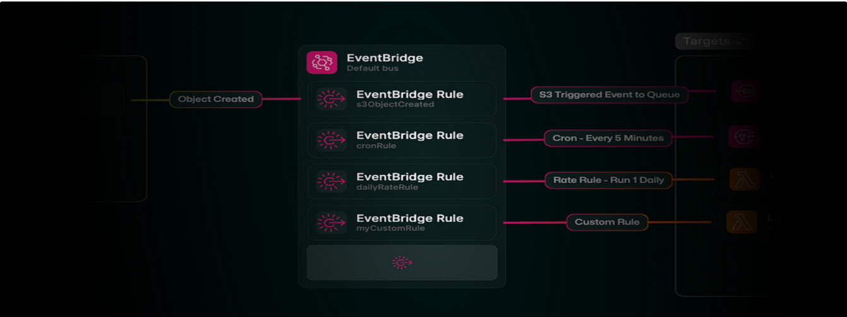




3/31/24, 8:45 PM
AWS CDK vs Terraform. An in-depth comparison of AWS CDK and… | by Stuart Cameron | Dev Axe | Medium
Follow
Written by Stuart Cameron
5 Followers · Editor for Dev Axe
More from Stuart Cameron and Dev Axe
Ciaran O'Keeffe in Dev Axe
AWS—Amazon EventBridge—Event Bus Explained
Explore Amazon EventBridge in this comprehensive guide, covering its core components, features, benefits, and use cases, and learn how it…
7 min read · Aug 29, 2023
47

Slide 9



3/31/24, 8:45 PM
AWS CDK vs Terraform. An in-depth comparison of AWS CDK and… | by Stuart Cameron | Dev Axe | Medium
Ant Stanley in Dev Axe
Cloud Complexity Paradox
The more undifferentiated heavy lifting you offload to the cloud, the more complex it becomes to use the cloud.
4 min read · Jun 20, 2023
4
See all from Stuart Cameron
See all from Dev Axe
Recommended from Medium

Slide 10
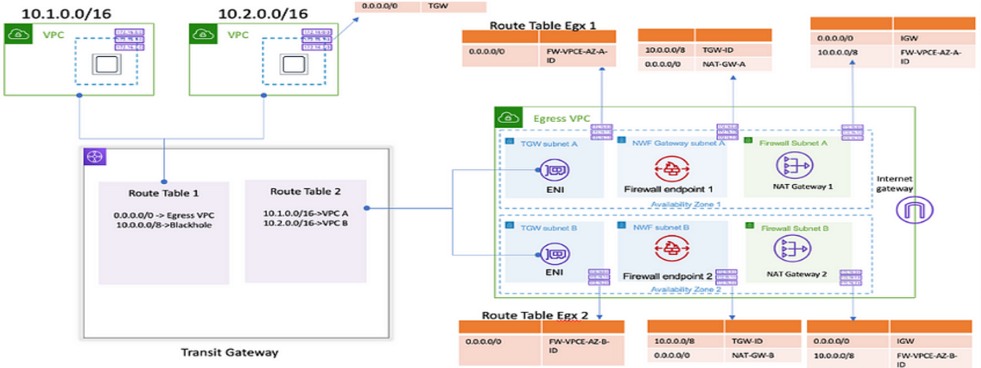
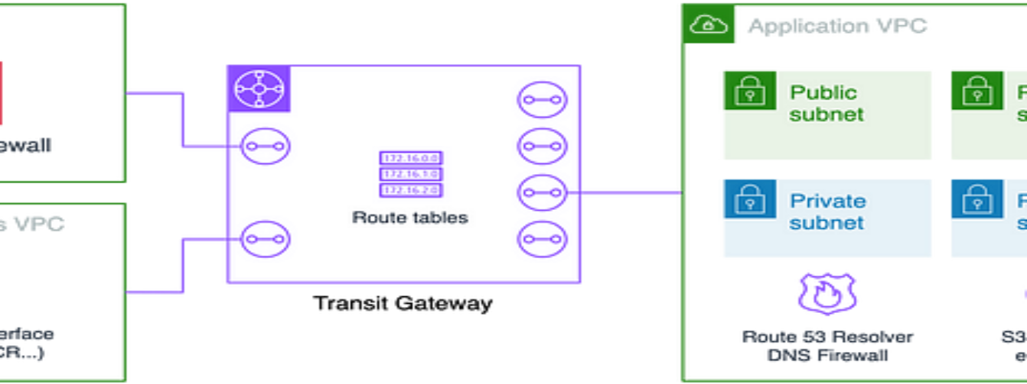

3/31/24, 8:45 PM
AWS CDK vs Terraform. An in-depth comparison of AWS CDK and… | by Stuart Cameron | Dev Axe | Medium
Andrew Larsen
How to reduce your AWS NAT Gateway bill
At Compoze Labs we manage dozens of AWS accounts, both for our customers and our own. As part of our management services we are always…
· 5 min read · Nov 22, 2023
168
2
Nicolas Malaval

Slide 11



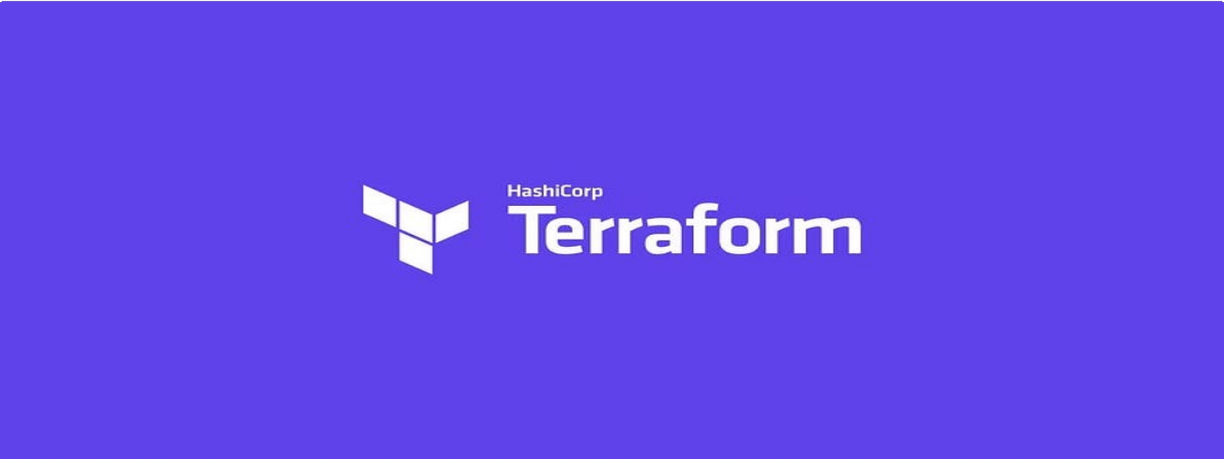

3/31/24, 8:45 PM AWS CDK vs Terraform. An in-depth comparison of AWS CDK and… | by Stuart Cameron | Dev Axe | Medium
Dive deep on our AWS landing zone: Architecture, Decisions made, Lessons learnt—Part 3
Other aspects of our landing zone on AWS: encryption at rest, network, backup, access to production and management ports, FinOps.
10 min read · Oct 4, 2023
41
1
Lists
Natural Language Processing
1340 stories · 821 saves
CJ Hewett
Packaging Python requirements as an AWS Lambda Layer with Terraform
It can be easier to create a Lambda layer, and let Lambda functions consume the layer, than attempting to package libraries up with your…
3 min read · Nov 14, 2023
8

Slide 12
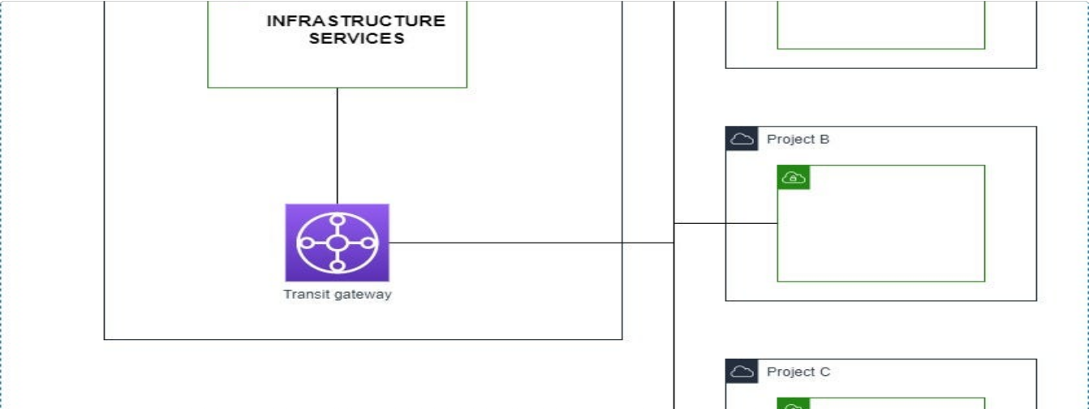

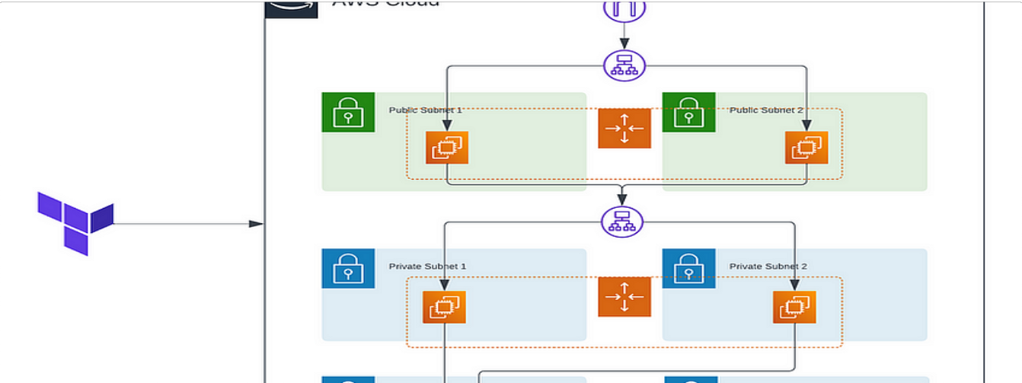
3/31/24, 8:45 PM
AWS CDK vs Terraform. An in-depth comparison of AWS CDK and… | by Stuart Cameron | Dev Axe | Medium
Mohamed Aït El Kamel in AWS Tip
AWS—From 1 to 1000s of VPCs, easy peasy!
When it comes to expand its AWS network, some mistake can lead to security vulnerabilities or routing issues. You’ll find below best…
5 min read · Jan 23, 2024
393
1
Mathesh M in Towards AWS

Slide 13
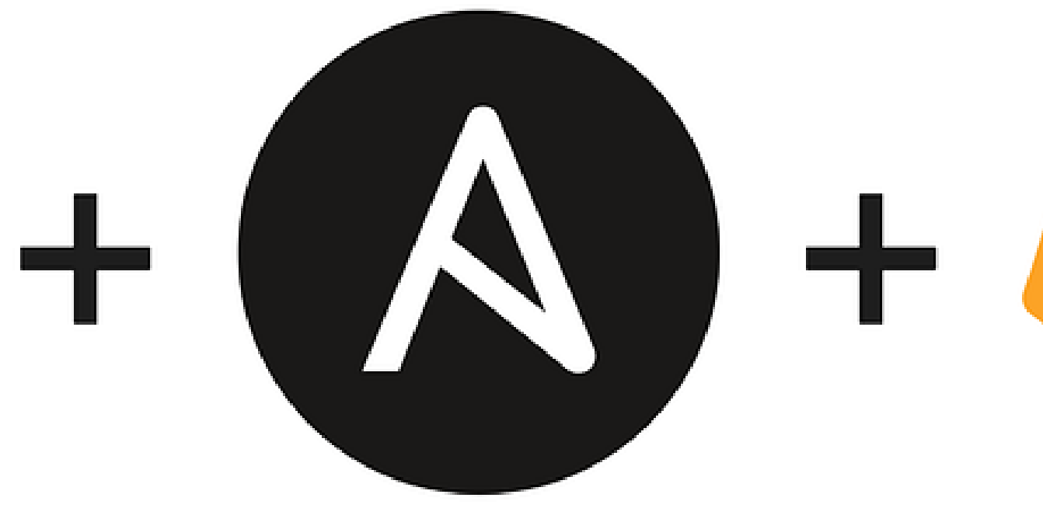
3/31/24, 8:45 PM AWS CDK vs Terraform. An in-depth comparison of AWS CDK and… | by Stuart Cameron | Dev Axe | Medium
Boost your Resume with these Five AWS Projects: Easy, Intermediate, and Expert Levels with…
In this blog, I will share some of the projects I have completed during my AWS learning journey. I hope they will be useful for you as…
5 min read · Feb 6, 2024
889
9
Prince Ogabi
Infrastructure as Code CI/CD using Terraform, Ansible and GitLab-CI
A dive into one of my interesting projects as a DevOps Engineer
12 min read · Oct 8, 2023
30
2
See more recommendations

